Slide 1
Chapter 10: Virtual Memory
Background
Demand Paging
Process Creation
Page Replacement
Allocation of Frames
Thrashing
Operating System Examples

Slide 2
Background
Virtual memory – separation of user logical memory from physical memory.
  Only part of the program needs to be in memory for execution.
  Logical address space can therefore be much larger than physical address space.
  Allows address spaces to be shared by several processes.
  Allows for more efficient process creation.
Virtual memory can be implemented via:
  Demand paging
  Demand segmentation

Slide 3
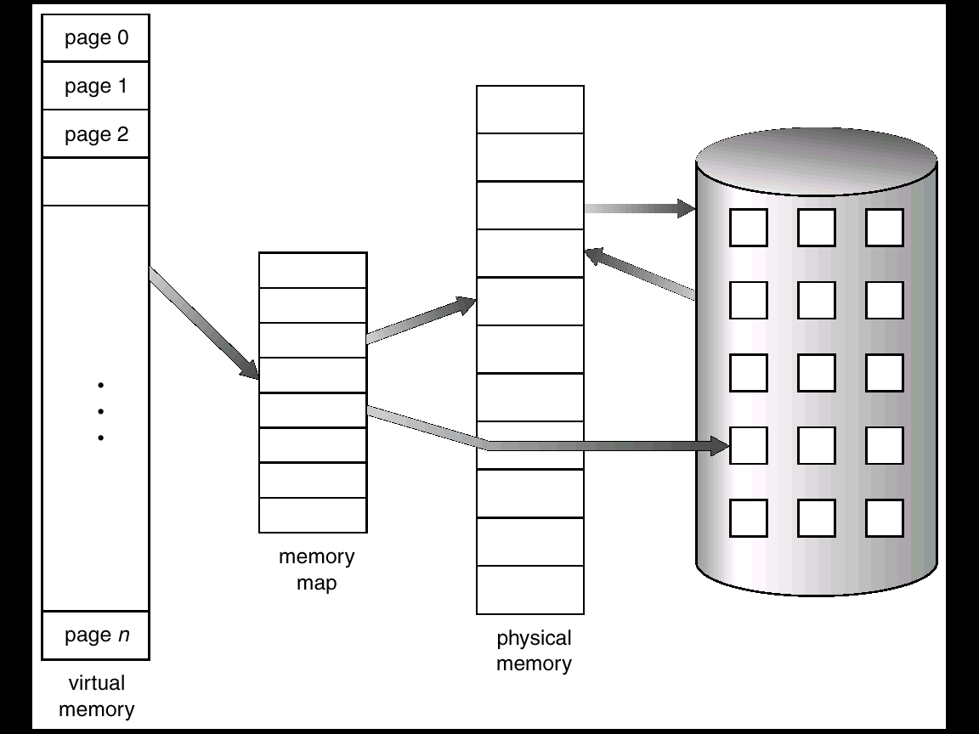
Virtual Memory That is Larger Than Physical Memory

Slide 4
Demand Paging
Bring a page into memory only when it is needed.
  Less I/O needed
  Less memory needed
  Faster response
  More users
Page is needed ⇒ reference to it
  invalid reference ⇒ abort
  not-in-memory ⇒ bring to memory

Slide 5
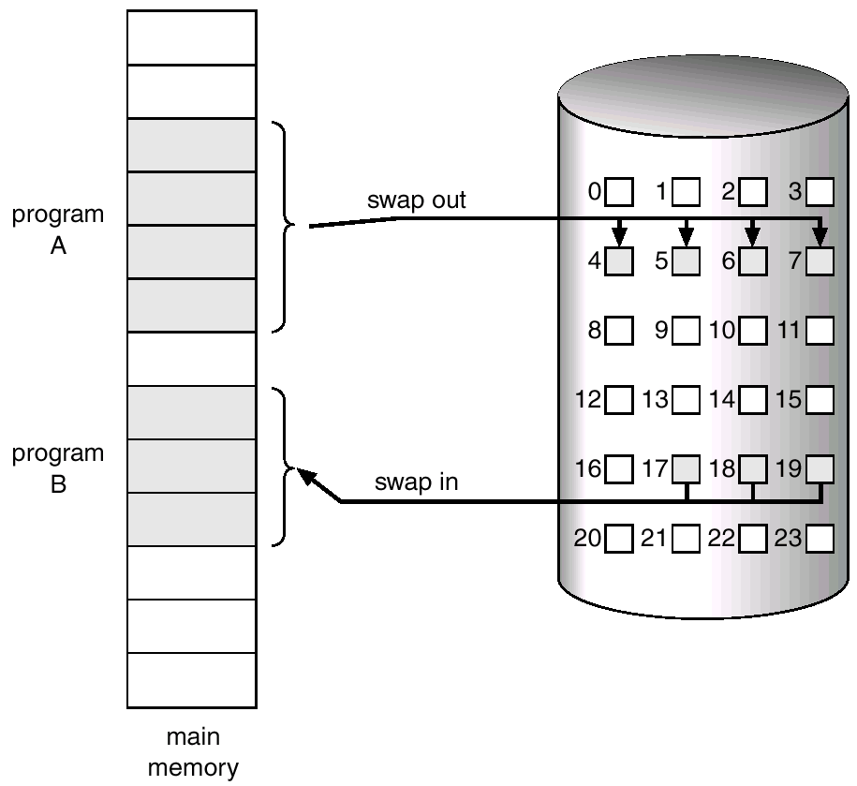
Transfer of a Paged Memory to Contiguous Disk Space

Slide 6
Valid-Invalid Bit
With each page table entry a valid–invalid bit is associated
(1 ⇒ in-memory, 0 ⇒ not-in-memory)
Initially valid–invalid but is set to 0 on all entries.
Example of a page table snapshot.
During address translation, if valid–invalid bit in page table entry is 0 ⇒ page fault.
Frame #
valid-invalid bit
1
1
1
1
0

0
0
page table

Slide 7
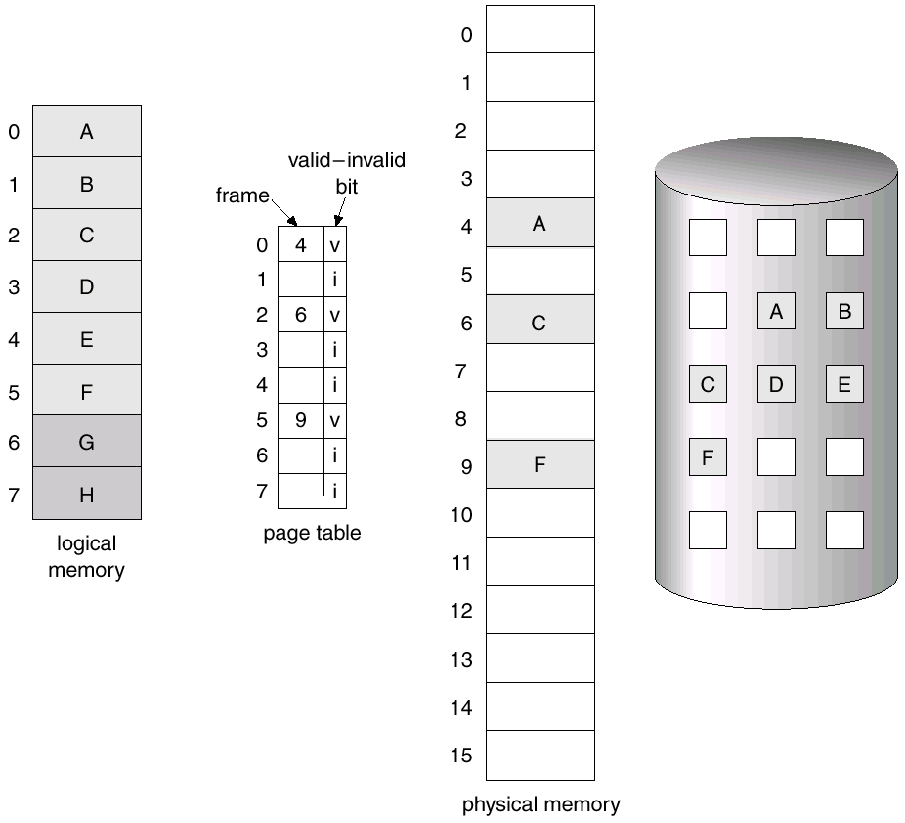
Page Table When Some Pages Are Not in Main Memory

Slide 8
Page Fault
If there is ever a reference to a page, first reference will trap to
OS ⇒ page fault
OS looks at another table to decide:
  Invalid reference ⇒ abort.
  Just not in memory.
Get empty frame.
Swap page into frame.
Reset tables, validation bit = 1.
Restart instruction: Least Recently Used
  block move
  auto increment/decrement location

Slide 9
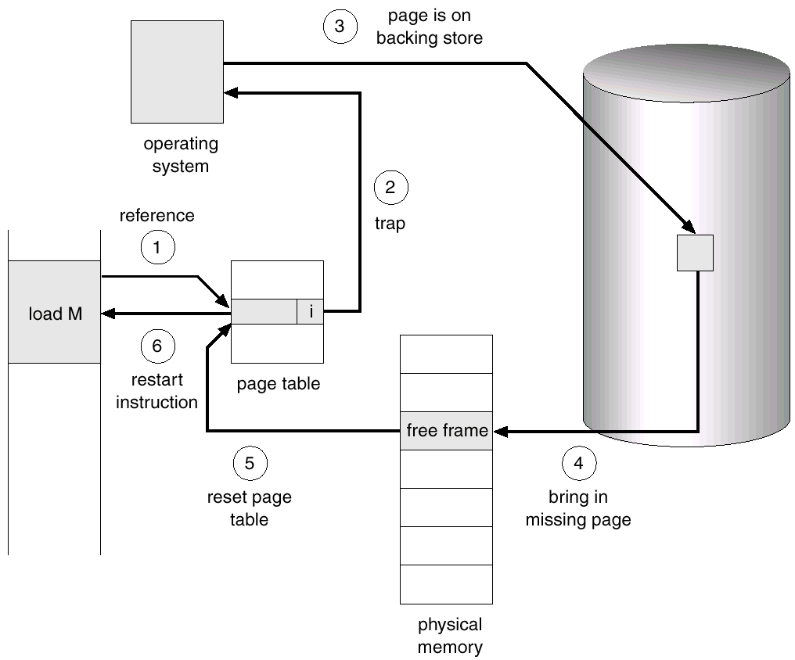
Steps in Handling a Page Fault

Slide 10
What happens if there is no free frame?
Page replacement – find some page in memory, but not really in use, swap it out.
  algorithm
  performance – want an algorithm which will result in minimum number of page faults.
Same page may be brought into memory several times.

Slide 11
Performance of Demand Paging
Page Fault Rate 0 ≤ p ≤ 1.0
  if p = 0 no page faults
  if p = 1, every reference is a fault
Effective Access Time (EAT)
EAT = (1 – p) x memory access
+ p (page fault overhead
+ [swap page out ]
+ swap page in
+ restart overhead)

Slide 12
Demand Paging Example
Memory access time = 1 microsecond
50% of the time the page that is being replaced has been modified and therefore needs to be swapped out.
Swap Page Time = 10 msec = 10,000 msec
EAT = (1 – p) x 1 + p (15000)
1 + 15000P (in msec)

Slide 13
Process Creation
Virtual memory allows other benefits during process creation:
- Copy-on-Write
- Memory-Mapped Files

Slide 14
Copy-on-Write
Copy-on-Write (COW) allows both parent and child processes to initially share the same pages in memory.
If either process modifies a shared page, only then is the page copied.
COW allows more efficient process creation as only modified pages are copied.
Free pages are allocated from a pool of zeroed-out pages.

Slide 15
Memory-Mapped Files
Memory-mapped file I/O allows file I/O to be treated as routine memory access by mapping a disk block to a page in memory.
A file is initially read using demand paging. A page-sized portion of the file is read from the file system into a physical page. Subsequent reads/writes to/from the file are treated as ordinary memory accesses.
Simplifies file access by treating file I/O through memory rather than read() write() system calls.
Also allows several processes to map the same file allowing the pages in memory to be shared.

Slide 16
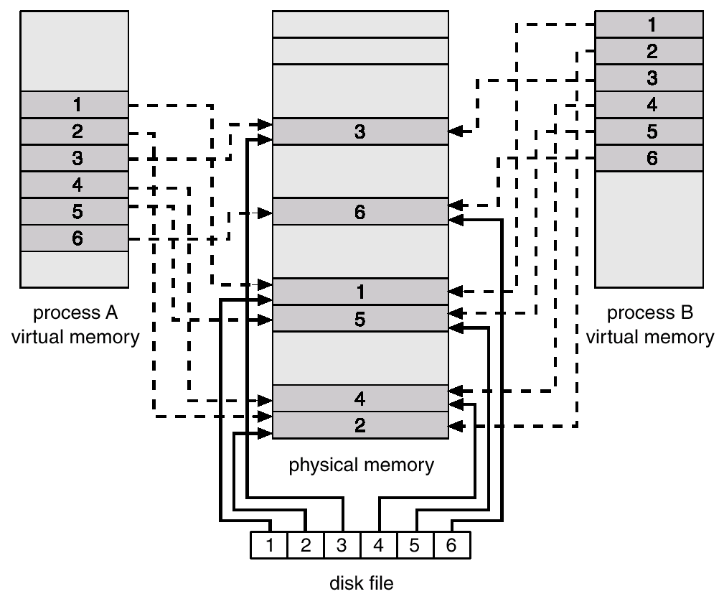
Memory Mapped Files

Slide 17
Page Replacement
Prevent over-allocation of memory by modifying page-fault service routine to include page replacement.
Use modify (dirty) bit to reduce overhead of page transfers – only modified pages are written to disk.
Page replacement completes separation between logical memory and physical memory – large virtual memory can be provided on a smaller physical memory.

Slide 18
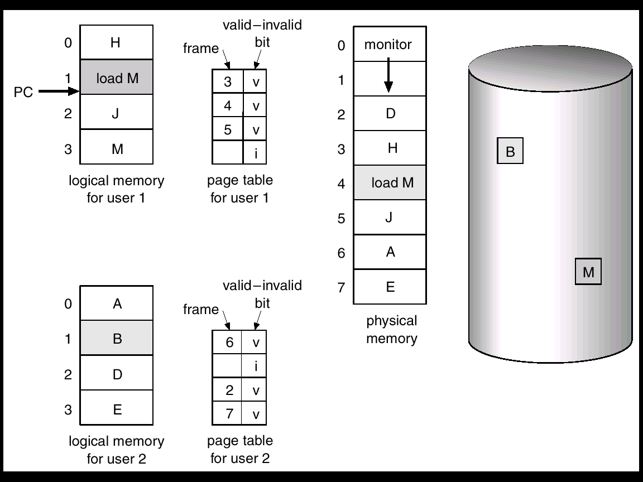
Need For Page Replacement

Slide 19
Basic Page Replacement
Find the location of the desired page on disk.
Find a free frame:
- If there is a free frame, use it.
- If there is no free frame, use a page replacement algorithm to select a victim frame.
Read the desired page into the (newly) free frame. Update the page and frame tables.
Restart the process.

Slide 20
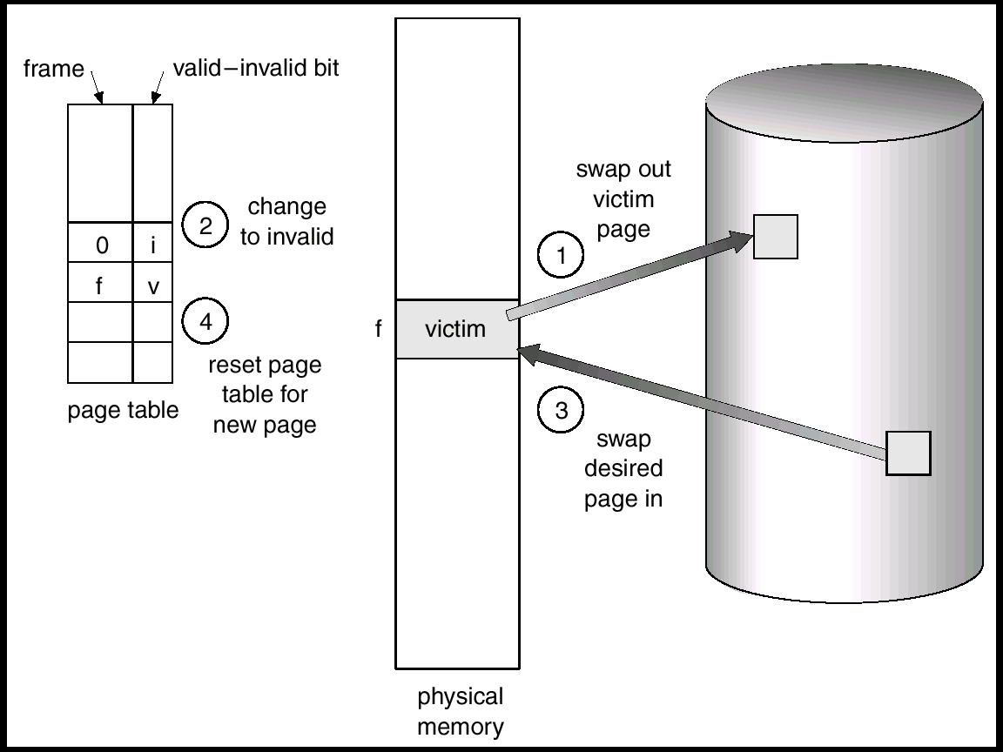
Page Replacement

Slide 21
Page Replacement Algorithms
Want lowest page-fault rate.
Evaluate algorithm by running it on a particular string of memory references (reference string) and computing the number of page faults on that string.
In all our examples, the reference string is
1, 2, 3, 4, 1, 2, 5, 1, 2, 3, 4, 5.

Slide 22
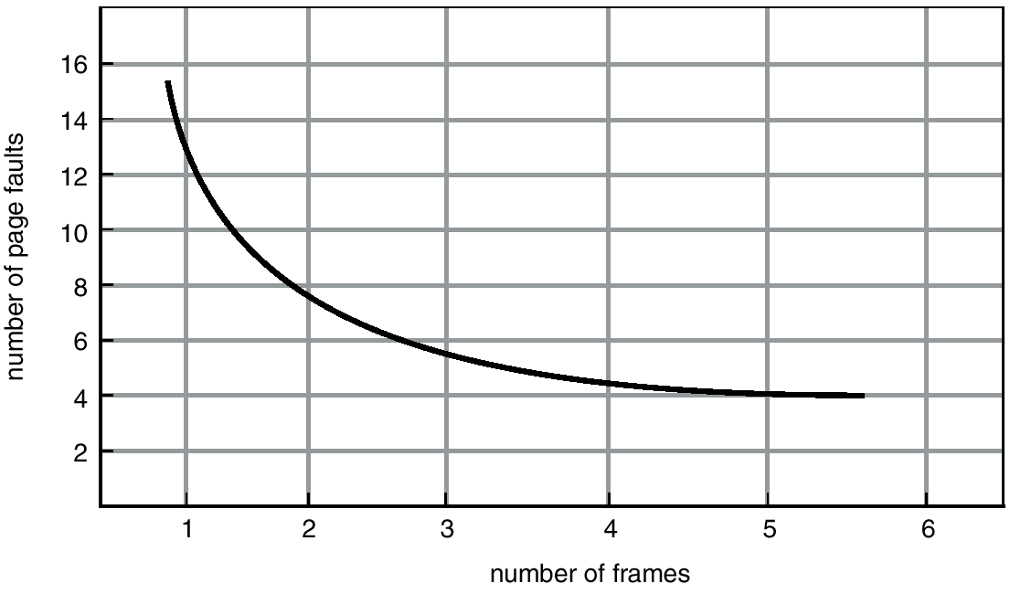
Graph of Page Faults Versus The Number of Frames

Slide 23
First-In-First-Out (FIFO) Algorithm
Reference string: 1, 2, 3, 4, 1, 2, 5, 1, 2, 3, 4, 5
3 frames (3 pages can be in memory at a time per process)
4 frames
FIFO Replacement – Belady’s Anomaly
  more frames ⇒ less page faults
1
1
4
5
2
2
1
3
9 page faults
3
3
2
4
1
1
5
4
2
2
1
5
10 page faults
3
3
2
4
4
3

Slide 24
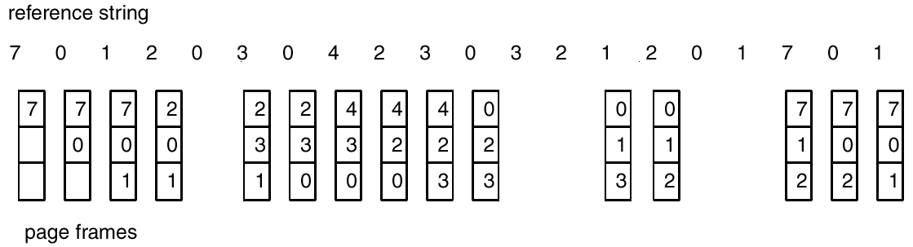
FIFO Page Replacement

Slide 25
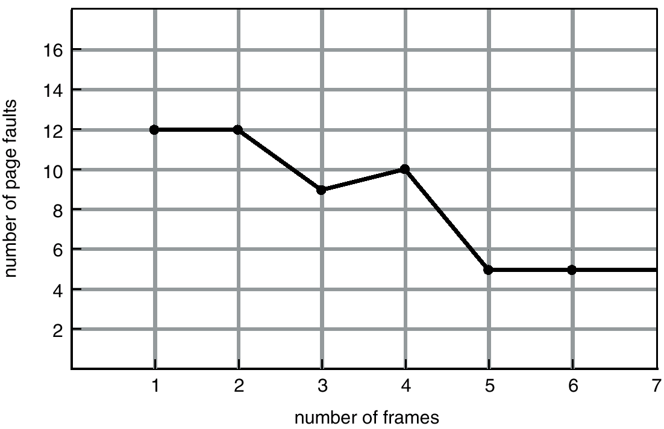
FIFO Illustrating Belady’s Anamoly

Slide 26
Optimal Algorithm
Replace page that will not be used for longest period of time.
4 frames example
1, 2, 3, 4, 1, 2, 5, 1, 2, 3, 4, 5
How do you know this?
Used for measuring how well your algorithm performs.
1
4
2
6 page faults
3
4
5

Slide 27
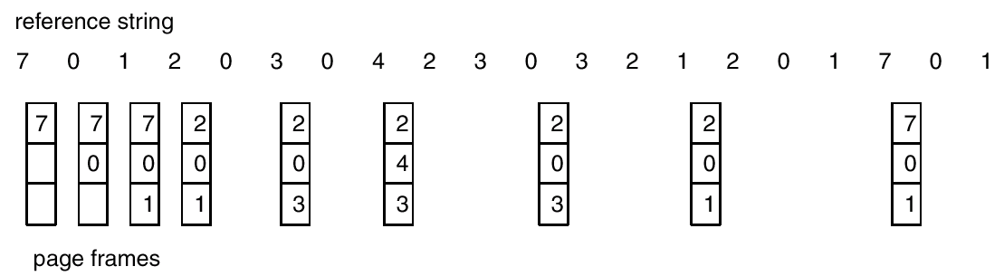
Optimal Page Replacement

Slide 28
Least Recently Used (LRU) Algorithm
Reference string: 1, 2, 3, 4, 1, 2, 5, 1, 2, 3, 4, 5
Counter implementation
  Every page entry has a counter; every time page is referenced through this entry, copy the clock into the counter.
  When a page needs to be changed, look at the counters to determine which are to change.
1
5
2
3
5
4
4
3

Slide 29
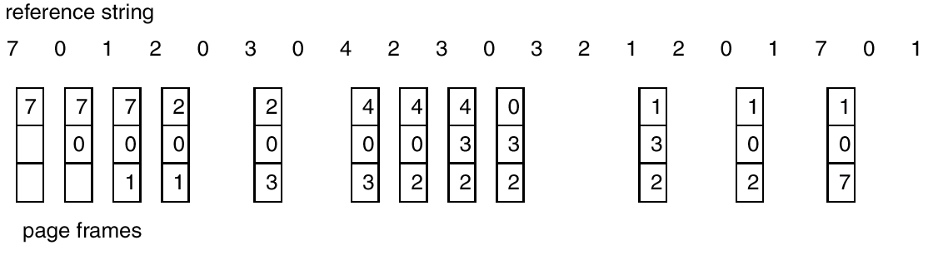
LRU Page Replacement

Slide 30
LRU Algorithm (Cont.)
Stack implementation – keep a stack of page numbers in a double link form:
  Page referenced:
    move it to the top
    requires 6 pointers to be changed
  No search for replacement

Slide 31
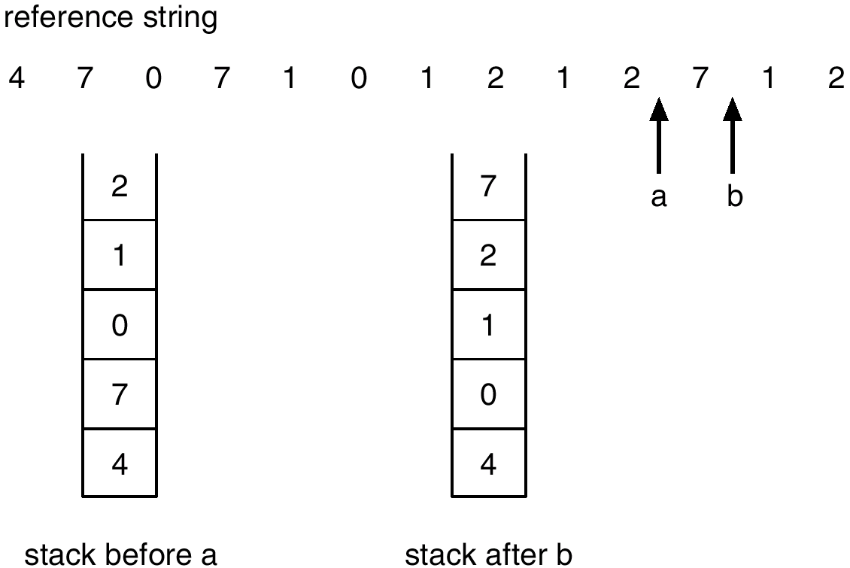
Use Of A Stack to Record The Most Recent Page References

Slide 32
LRU Approximation Algorithms
Reference bit
  With each page associate a bit, initially = 0
  When page is referenced bit set to 1.
  Replace the one which is 0 (if one exists). We do not know the order, however.
Second chance
  Need reference bit.
  Clock replacement.
  If page to be replaced (in clock order) has reference bit = 1. then:
    set reference bit 0.
    leave page in memory.
    replace next page (in clock order), subject to same rules.

Slide 33
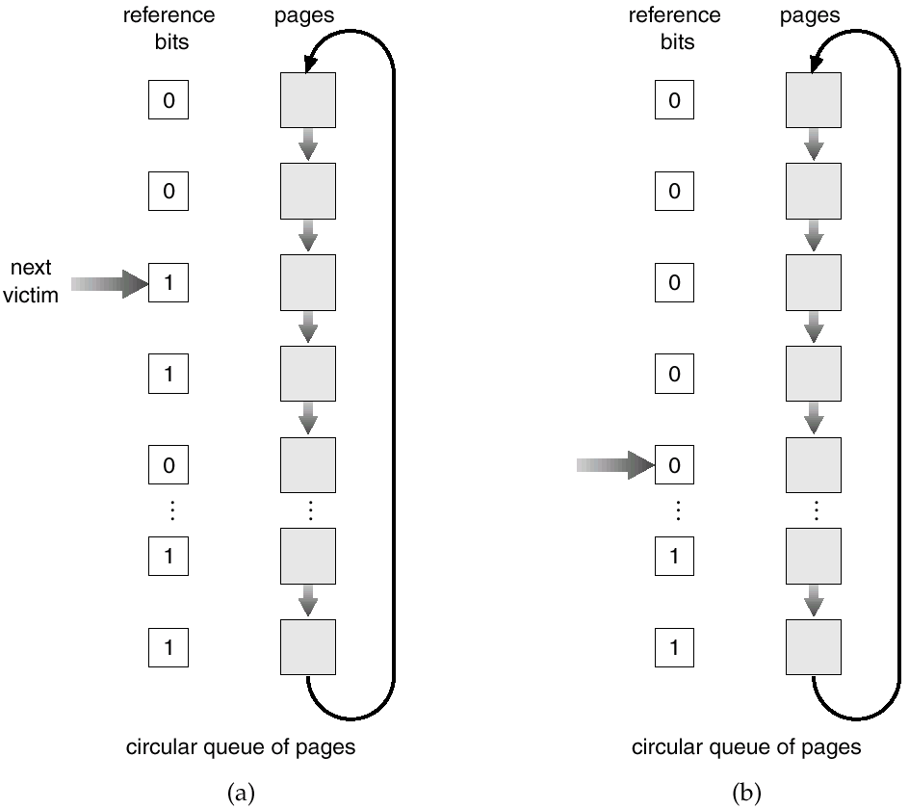
Second-Chance (clock) Page-Replacement Algorithm

Slide 34
Counting Algorithms
Keep a counter of the number of references that have been made to each page.
LFU Algorithm: replaces page with smallest count.
MFU Algorithm: based on the argument that the page with the smallest count was probably just brought in and has yet to be used.

Slide 35
Allocation of Frames
Each process needs minimum number of pages.
Example: IBM 370 – 6 pages to handle SS MOVE instruction:
  instruction is 6 bytes, might span 2 pages.
  2 pages to handle from.
  2 pages to handle to.
Two major allocation schemes.
  fixed allocation
  priority allocation

Slide 36
Fixed Allocation
Equal allocation – e.g., if 100 frames and 5 processes, give each 20 pages.
Proportional allocation – Allocate according to the size of process.

Slide 37
Priority Allocation
Use a proportional allocation scheme using priorities rather than size.
If process P_{i} generates a page fault,
  select for replacement one of its frames.
  select for replacement a frame from a process with lower priority number.

Slide 38
Global vs. Local Allocation
Global replacement – process selects a replacement frame from the set of all frames; one process can take a frame from another.
Local replacement – each process selects from only its own set of allocated frames.

Slide 39
Thrashing
If a process does not have “enough” pages, the page-fault rate is very high. This leads to:
  low CPU utilization.
  operating system thinks that it needs to increase the degree of multiprogramming.
  another process added to the system.
Thrashing ≡ a process is busy swapping pages in and out.

Slide 40
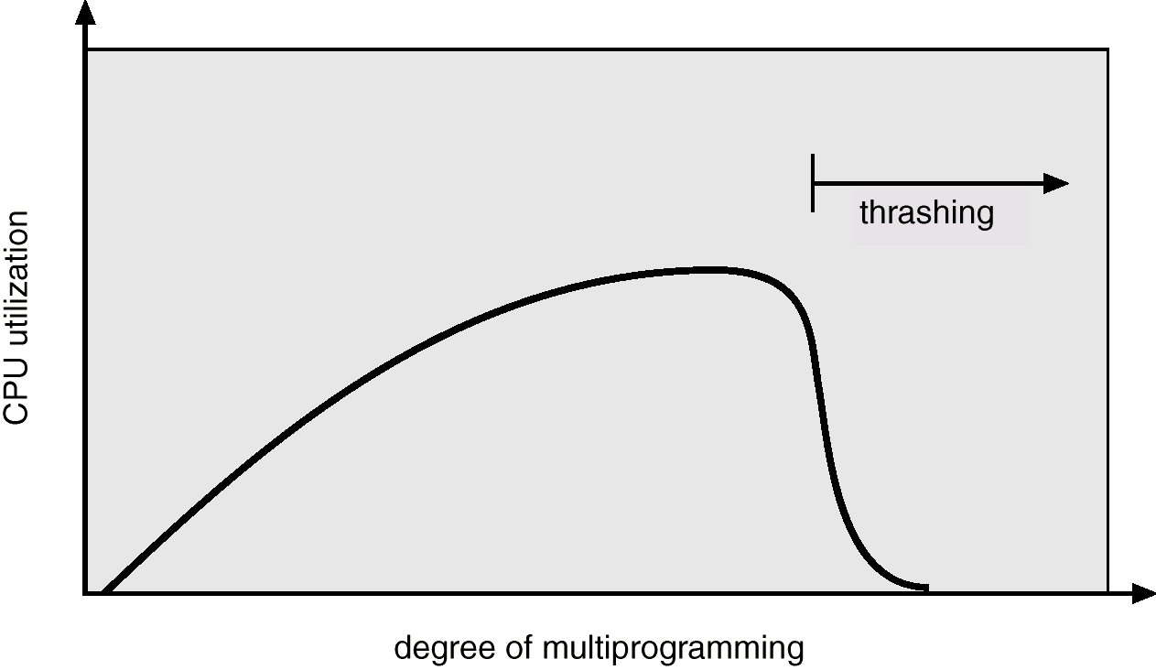
Thrashing
Why does paging work?
Locality model
  Process migrates from one locality to another.
  Localities may overlap.
Why does thrashing occur?
Σ size of locality > total memory size

Slide 41
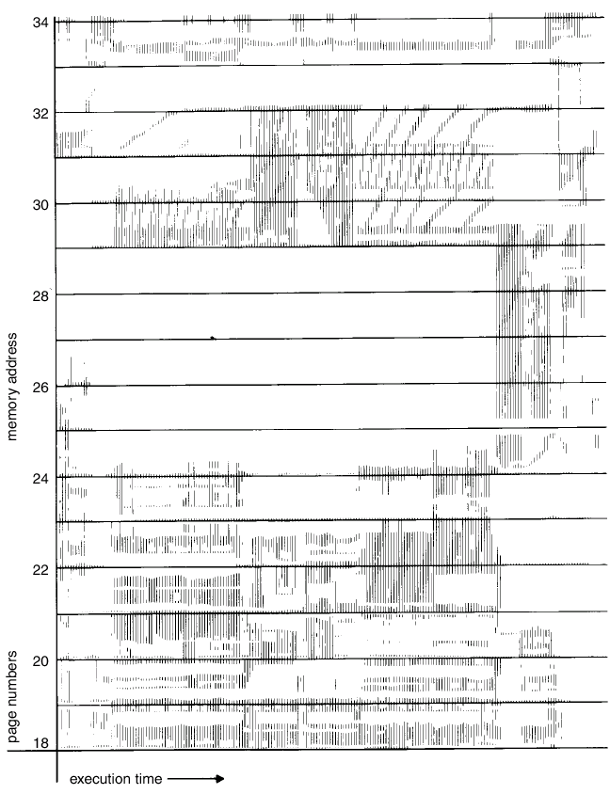
Locality In A Memory-Reference Pattern

Slide 42
Working-Set Model
Δ ≡ working-set window ≡ a fixed number of page references
Example: 10,000 instruction
WSS_{i} (working set of Process P_{i}) =
total number of pages referenced in the most recent Δ (varies in time)
  if Δ too small will not encompass entire locality.
  if Δ too large will encompass several localities.
  if Δ = ∞ ⇒ will encompass entire program.
D = Σ WSS_{i} ≡ total demand frames
if D > m ⇒ Thrashing
Policy if D > m, then suspend one of the processes.

Slide 43
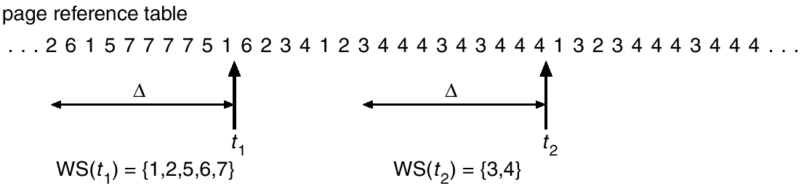
Working-set model

Slide 44
Keeping Track of the Working Set
Approximate with interval timer + a reference bit
Example: Δ = 10,000
  Timer interrupts after every 5000 time units.
  Keep in memory 2 bits for each page.
  Whenever a timer interrupts copy and sets the values of all reference bits to 0.
  If one of the bits in memory = 1 ⇒ page in working set.
Why is this not completely accurate?
Improvement = 10 bits and interrupt every 1000 time units.

Slide 45
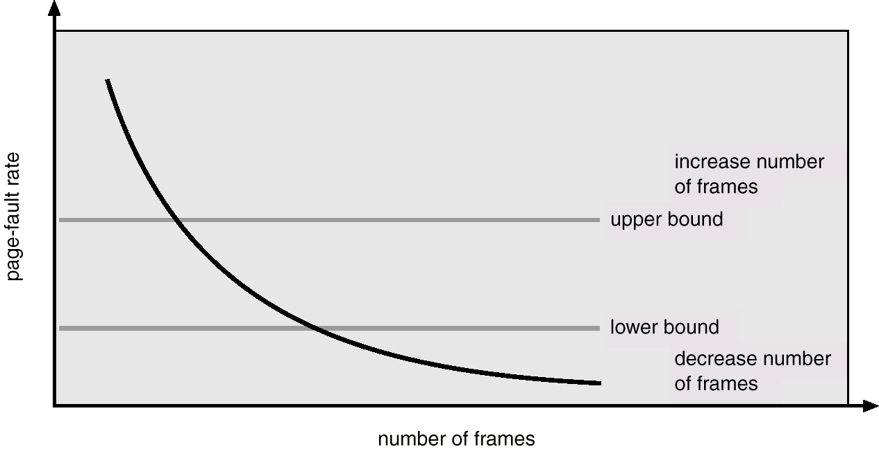
Page-Fault Frequency Scheme
Establish “acceptable” page-fault rate.
  If actual rate too low, process loses frame.
  If actual rate too high, process gains frame.

Slide 46
Other Considerations
Prepaging
Page size selection
  fragmentation
  table size
  I/O overhead
  locality

Slide 47
Other Considerations (Cont.)
TLB Reach - The amount of memory accessible from the TLB.
TLB Reach = (TLB Size) X (Page Size)
Ideally, the working set of each process is stored in the TLB. Otherwise there is a high degree of page faults.

Slide 48
Increasing the Size of the TLB
Increase the Page Size. This may lead to an increase in fragmentation as not all applications require a large page size.
Provide Multiple Page Sizes. This allows applications that require larger page sizes the opportunity to use them without an increase in fragmentation.

Slide 49
Other Considerations (Cont.)
Program structure
  int A[][] = new int[1024][1024];
  Each row is stored in one page
  Program 1 for (j = 0; j < A.length; j++)
  for (i = 0; i < A.length; i++)
  A[i,j] = 0;
  1024 x 1024 page faults
  Program 2 for (i = 0; i < A.length; i++)
  for (j = 0; j < A.length; j++)
  A[i,j] = 0;
  1024 page faults

Slide 50
Other Considerations (Cont.)
I/O Interlock – Pages must sometimes be locked into memory.
Consider I/O. Pages that are used for copying a file from a device must be locked from being selected for eviction by a page replacement algorithm.

Slide 51
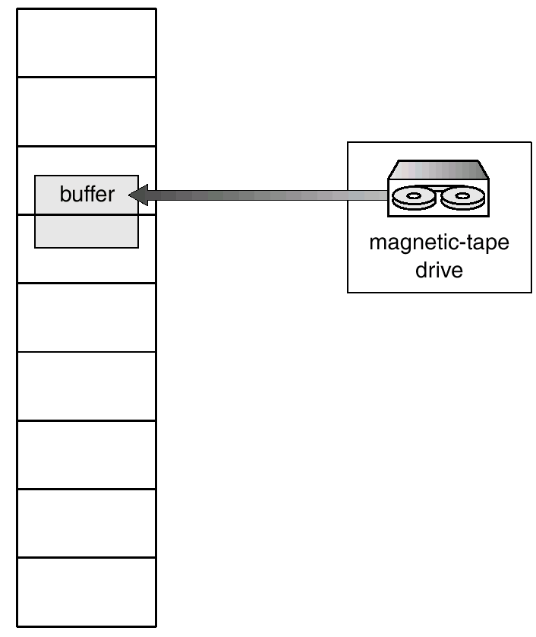
Reason Why Frames Used For I/O Must Be In Memory

Slide 52
Operating System Examples
Windows NT
Solaris 2

Slide 53
Windows NT
Uses demand paging with clustering. Clustering brings in pages surrounding the faulting page.
Processes are assigned working set minimum and working set maximum.
Working set minimum is the minimum number of pages the process is guaranteed to have in memory.
A process may be assigned as many pages up to its working set maximum.
When the amount of free memory in the system falls below a threshold, automatic working set trimming is performed to restore the amount of free memory.
Working set trimming removes pages from processes that have pages in excess of their working set minimum.

Slide 54
Solaris 2
Maintains a list of free pages to assign faulting processes.
Lotsfree – threshold parameter to begin paging.
Paging is peformed by pageout process.
Pageout scans pages using modified clock algorithm.
Scanrate is the rate at which pages are scanned. This ranged from slowscan to fastscan.
Pageout is called more frequently depending upon the amount of free memory available.

Slide 55
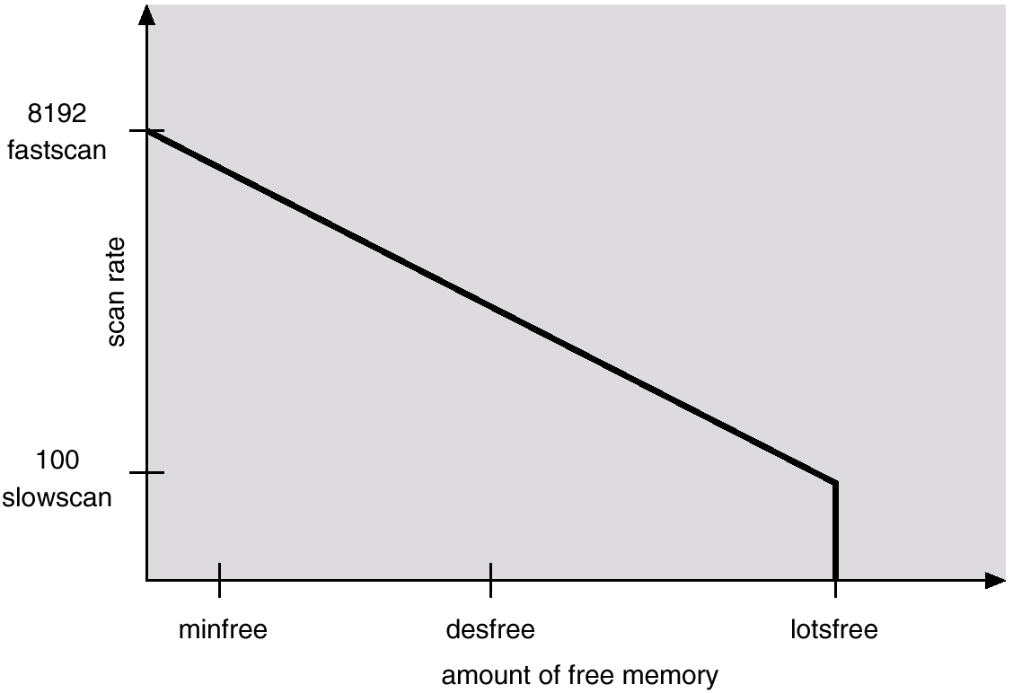
Solar Page Scanner

